Slide 1
Applied Physics
Unit 5: Dielectric Materials, Magnetic Materials & Superconducting materials
Dr. G. Patrick

Slide 2
UNIT V
Dielectric Materials: Introduction, Types of polarizations (Electronic, Ionic and Orientational Polarizations) and calculation of Electronic and Ionic polarizability.
Magnetic Materials: Introduction, Bohr magneton, classification of dia, para and ferro magnetic materials on the basis of magnetic moment, Hysteresis curve based on domain theory, Soft and hard magnetic materials, Properties of anti-ferro and ferri magnetic materials.
Superconducting materials: Introduction to superconductors, General properties, Meissner effect, Type I and Type II superconductors, Applications of superconducting materials.

Slide 3
Dielectric Materials
Dielectric Materials are Insulators with no free electrons.
When placed in electric field they are polarized.
They are non-conductors of electricity with special properties in the presence of the electric field.
Example: Glass, mica, polymers
Dielectrics may be polar or non-polar

Slide 4
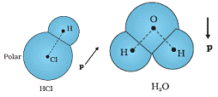
Polar dielectric
A Polar molecule is one in which the centre of gravity of the positive charge is separated by a finite distance from the centre of gravity of the negative charge.
They have permanent dipole moment.
Polarization of molecule strongly depends on the temperature.
Eg. HCl, H₂O

Slide 5
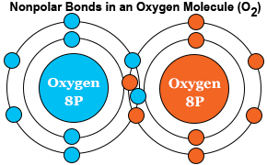
NonPolar dielectric
A non polar molecule is one in which the centre of gravity of the positive charge and negative charge coincide.
They do not have permanent dipole moment.
The polarization of non-polar molecules is independent of temperature.
Eg. Oxygen molecule, H_{2,} N₂

Slide 6
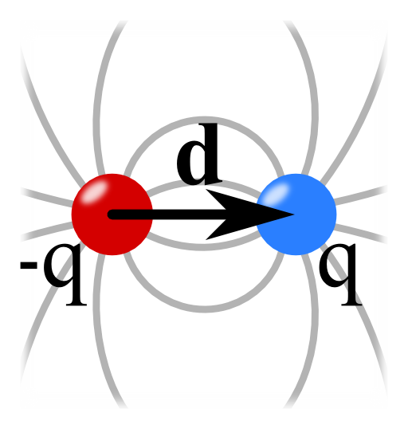
Electric dipole
Electric dipole: Two equal and opposite charges small in magnitude and separated by a small distance constitute a electric dipole.
It is a vector , the direction is from negative to positive charge.

Slide 7
Electric dipole moment
It is the product of magnitude of charge and the distance between the two charges.
µ = q * d

Slide 8
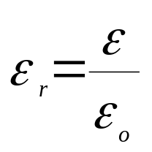
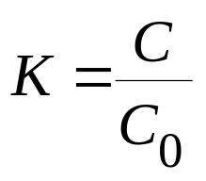
Dielectric Constant or relative permittivity
Dielectric constant is the ratio between the permittivity of the medium to permittivity of free space.
It is also defined as the capacitance of the capacitor with dielectric to capacitance of the same capacitor without dielectric.
It is a measure of the electric polarization in the dielectric material and it has no units.
Materials with higher dielectric constant are easily polarized and behaves as good electrical insulators

Slide 9
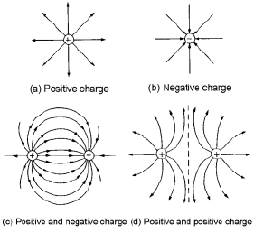
Electric flux
Electric field is the space around a charge where its influence can be felt.
Electric flux(Phi = Φ) is the total number of electric field lines coming out from a charge. Measured in Columb.

Slide 10
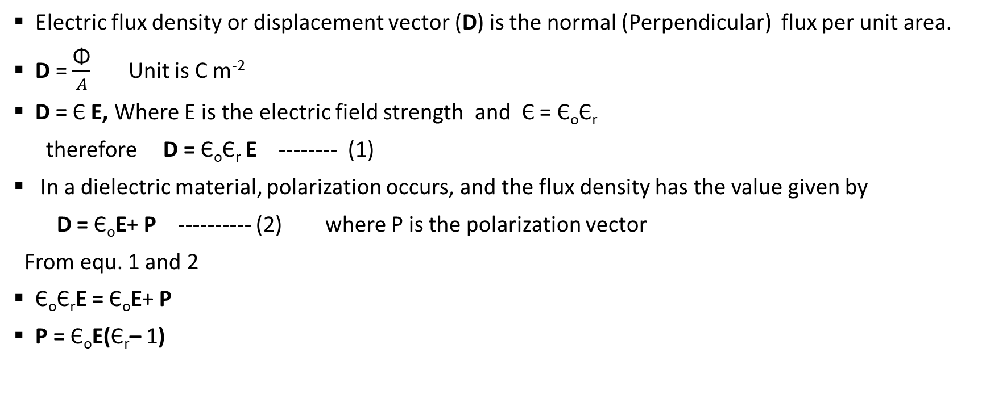
Electric flux density & electric susceptibility

Slide 11
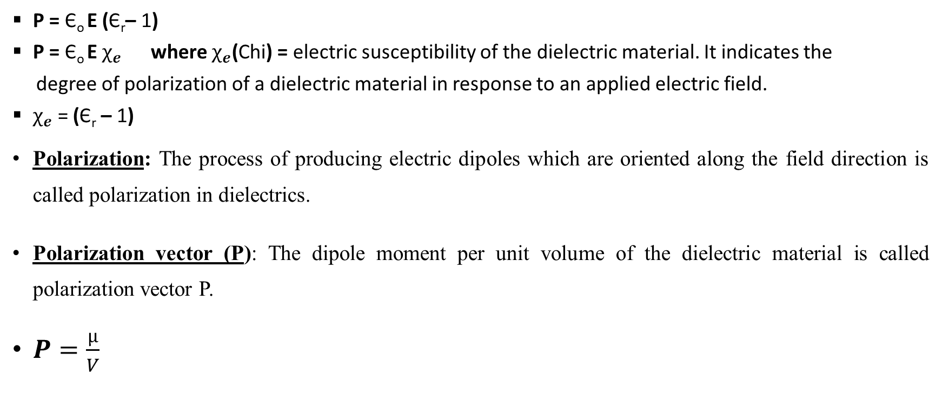
Electric flux density & electric susceptibility

Slide 12
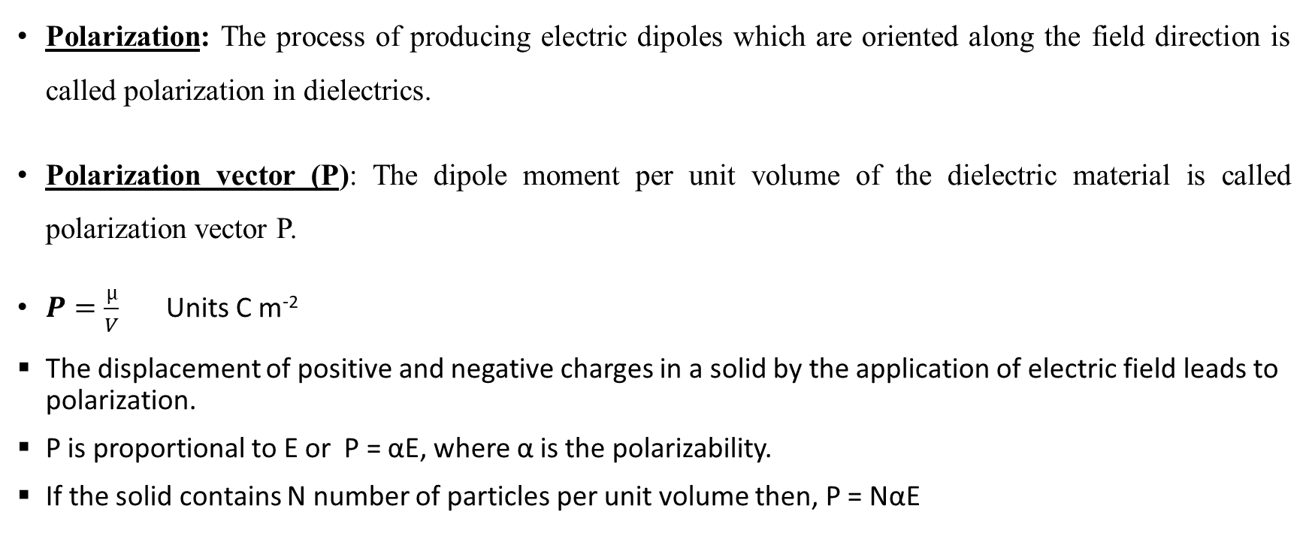
Polarization

Slide 13
Types of Polarization
Polarization occurs due to several atomic mechanisms. When the specimen is placed inside electric field, mainly three types of polarizations are possible. These are
Electronic Polarization
Ionic Polarization or Atomic Polarization
Orientational or Dipolar polarization

Slide 14
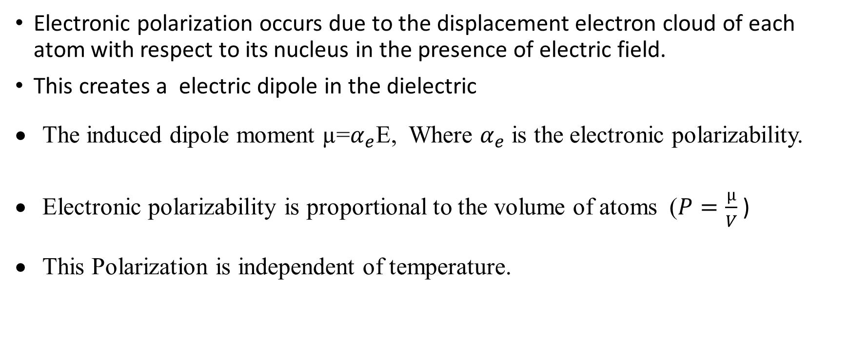
Electronic polarization

Slide 15
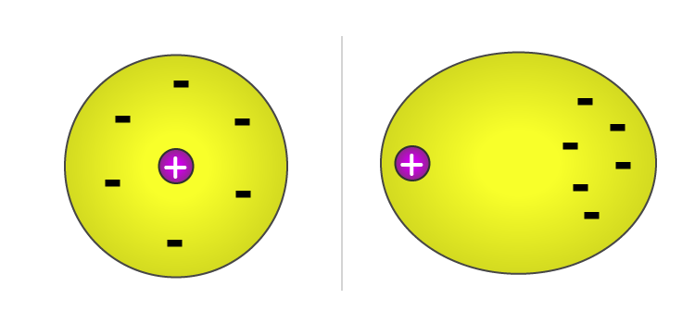
Electronic polarization

Slide 16
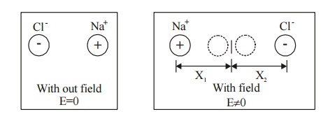
Ionic or Atomic Polarization
When an electric field is applied to an ionic crystal, the polarization that arises due to the displacement of the positive ions away from the field and the displacement of the negative ions towards the field is known as ionic polarization.
This type of polarization occurs in ionic molecules such as e NaCl, KBr, KCl and LiBr.

Slide 17
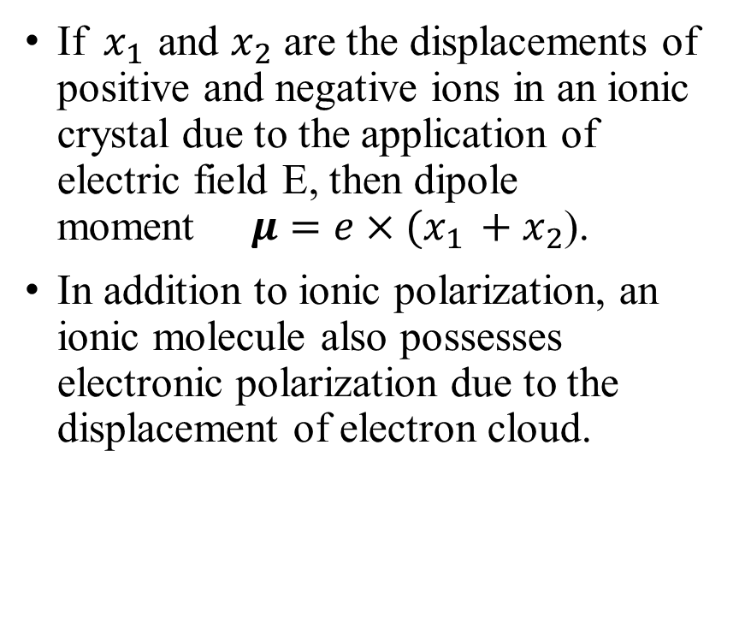
Ionic Polarization

Slide 18
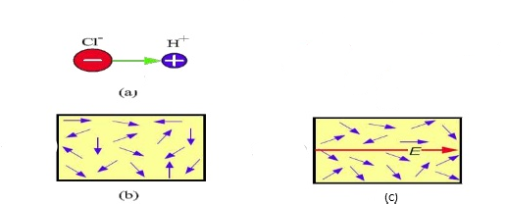
Orientation or Dipolar Polarization
The Orientation or dipolar polarization is produced only in polar molecules like HCl, H₂O and Nitrobenzene.
When an electric field is applied to a polar molecule, the dipole experience a torque and try to align parallel to the applied field, which results in a rotation of the dipole.
Orientation polarizability is inversely proportional to temperature.

Slide 19
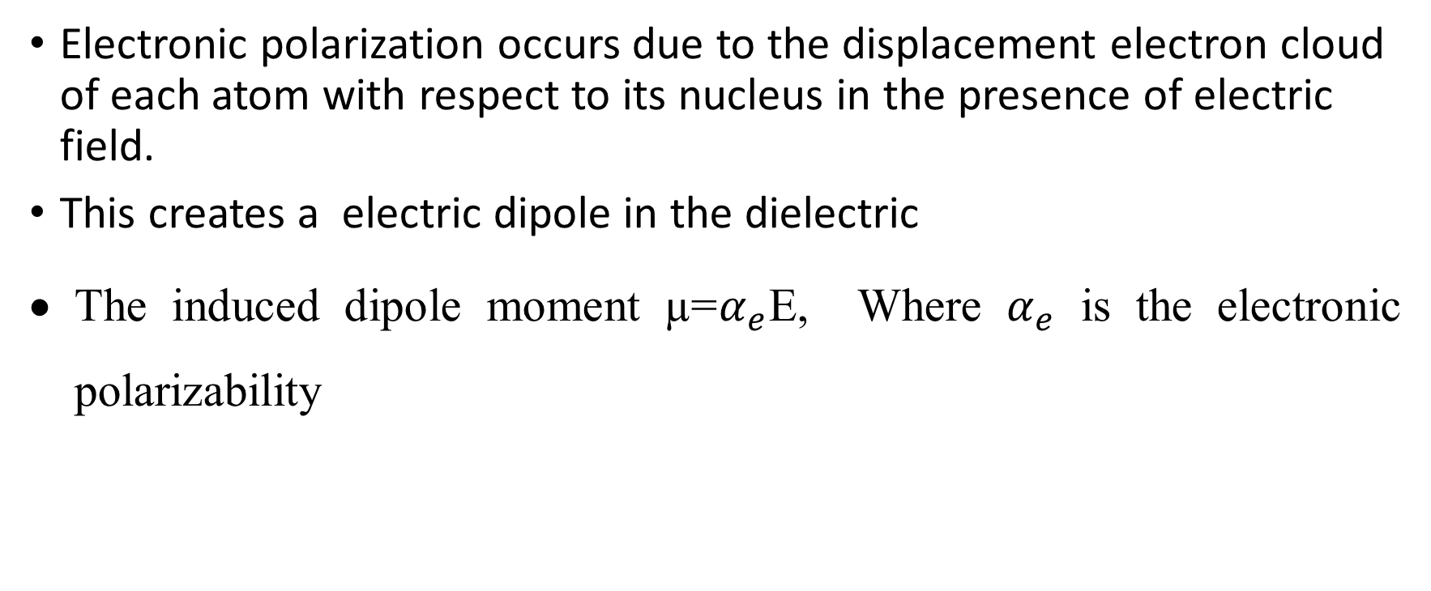
Electronic Polarization

Slide 20
Electronic polarization

Slide 21


Electronic Polarization
Calculation of electronic polarizability:
(I) Without Electric field:
Let us consider a classical model of an atom. Assume the charge of the nucleus is +Ze and the nucleus is surrounded by an electron cloud of charge –Ze, which is distributed in sphere of radius R.
The charge density of the sphere =
Charge density --- (1)

Slide 22
Electronic Polarization
With Electric field:
When the dielectric is placed in an electric field E, two phenomena occurs
Lorentz force due to the electric field tends to separate the nucleus and the electron cloud from their equilibrium position.
After the separation, an attractive coulomb force arises between the nucleus and electron cloud which tries to maintain the original equilibrium position.
At equilibrium Lorentz force = Coulomb force and let x be the displacement made by the electron cloud from the positive core .

Slide 23

Electronic Polarization
At equilibrium Lorentz force = Coulomb force
Lorentz force = charge * field = -ZeE -------2
Coulomb force = charge * field = +Ze *
Q is the charge enclosed in a sphere of radius x
Q = charge density of the electron * volume of the sphere

Slide 24

Electronic Polarization
Q = *
Q = -
Coulomb force = +Ze *
Substitute the value of Q

Slide 25


Electronic Polarization
Coulomb force = * - ---- (3)
At equilibrium Lorentz force = Coulomb force
Equate equ. (2) and (3)
-ZeE = * -
X =

Slide 26

Electronic Polarization
Induced dipole moment = magnitude of charge * displacement = Ze * X
= Ze *
=
= * E
where =
This is called electronic polarizability

Slide 27
Ionic or Atomic Polarization
When an electric field is applied to an ionic crystal, the polarization that arises due to the displacement of the positive ions away from the field and the displacement of the negative ions towards the field is known as ionic polarization.
This type of polarization occurs in ionic molecules such as NaCl, KBr, KCl and LiBr.

Slide 28
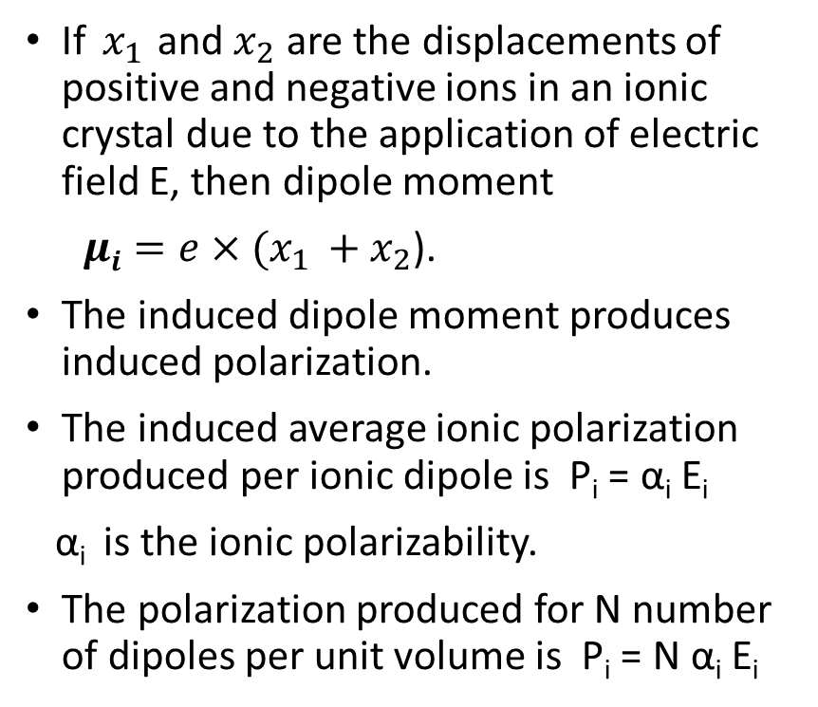
Ionic Polarization

Slide 29
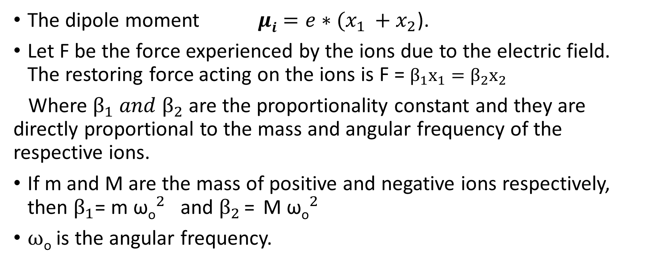
Ionic Polarization

Slide 30
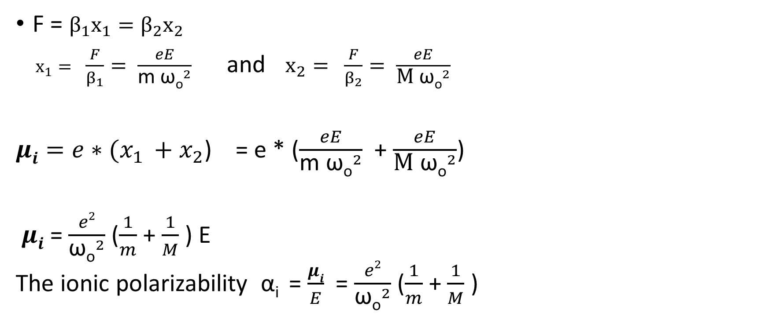
Ionic Polarization

Slide 31
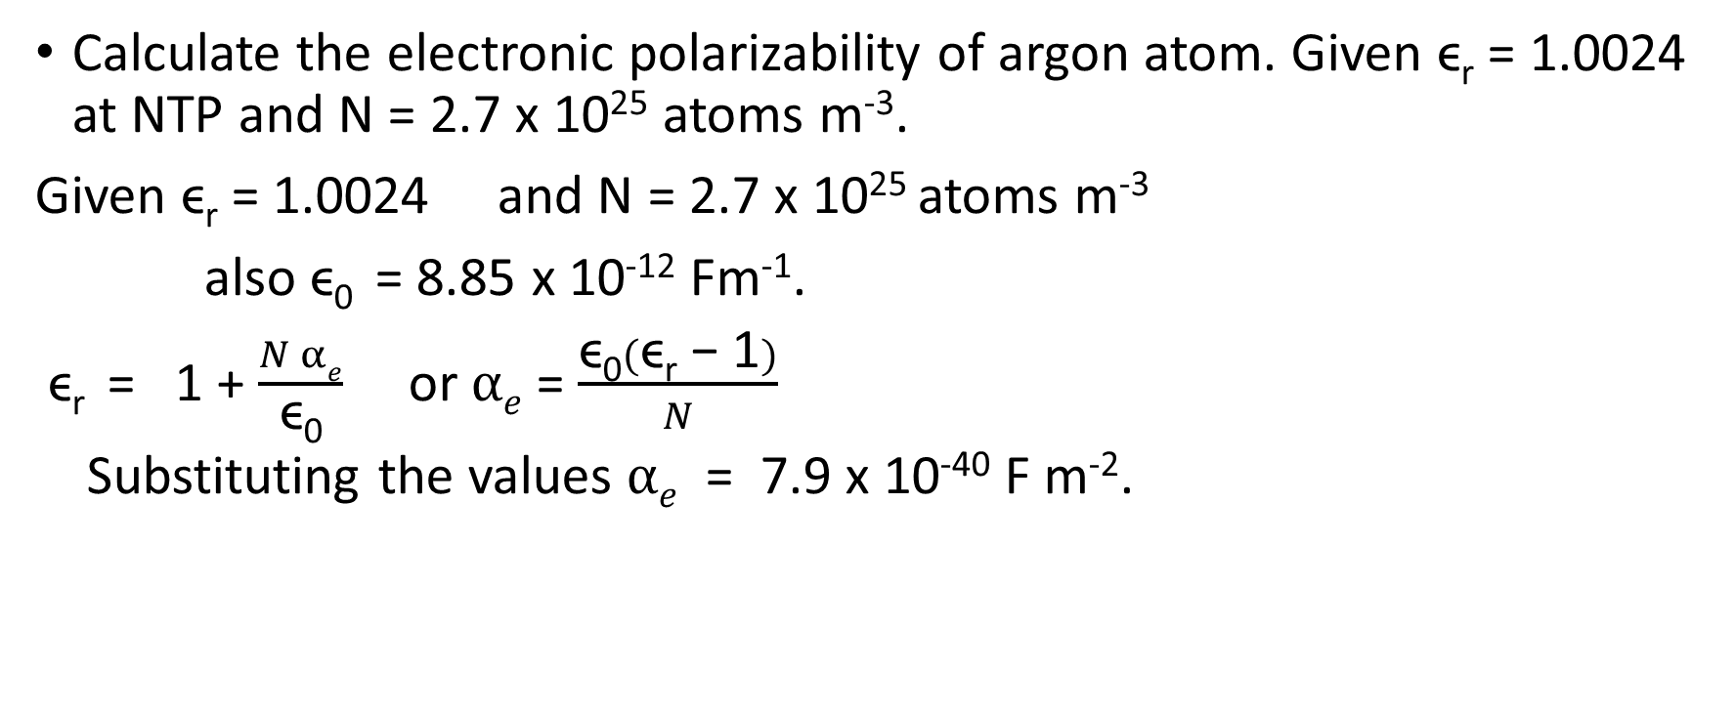
Numericals: Dielectric material

Slide 32
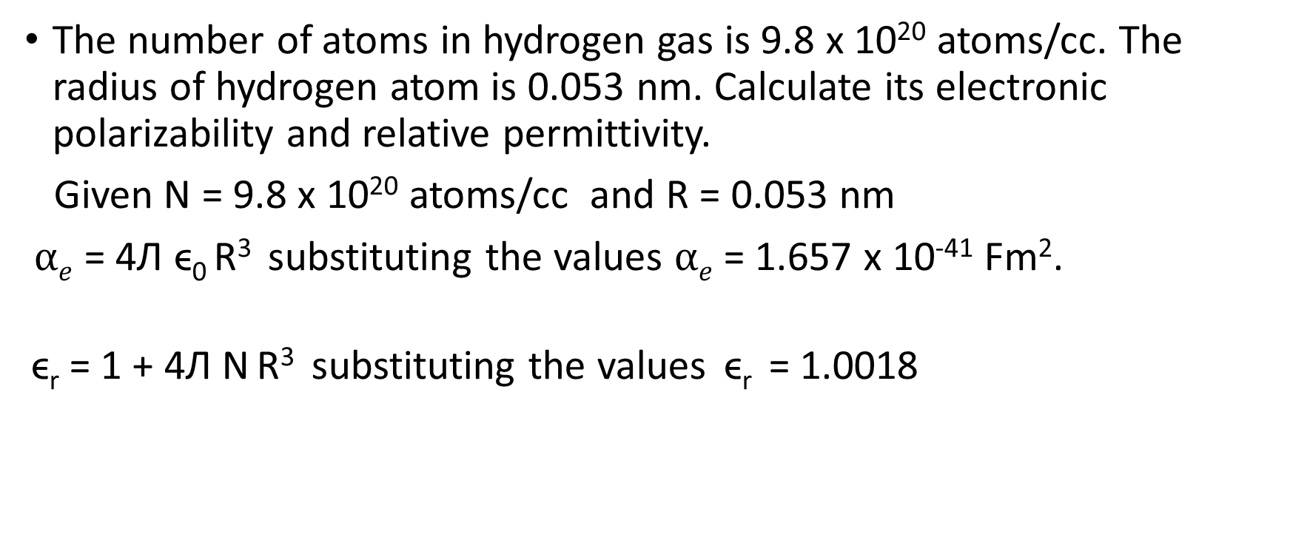
Numericals: Dielectric material

Slide 33
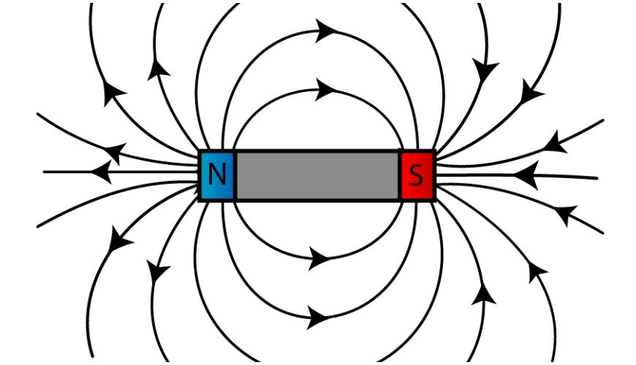
Magnetic Materials
Magnetic field
Magnetic field: The region around a magnet in which it exerts forces on other magnets or on other magnetic material is called a magnetic field.
Magnetism arises from the Magnetic dipole of Magnetic Materials.

Slide 34
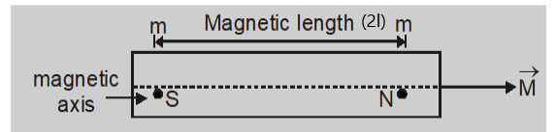
Magnetic dipole
A pair of magnetic poles of equal and opposite strengths separated by a finite distance is called a magnetic dipole.
The magnitude of dipole moment is the product of the pole strength ‘m’ and the separation ‘2l’ between the poles.
M = m.2l Units: Am²
The direction of the dipole moment is from South pole to North Pole along the axis of the magnet.

Slide 35
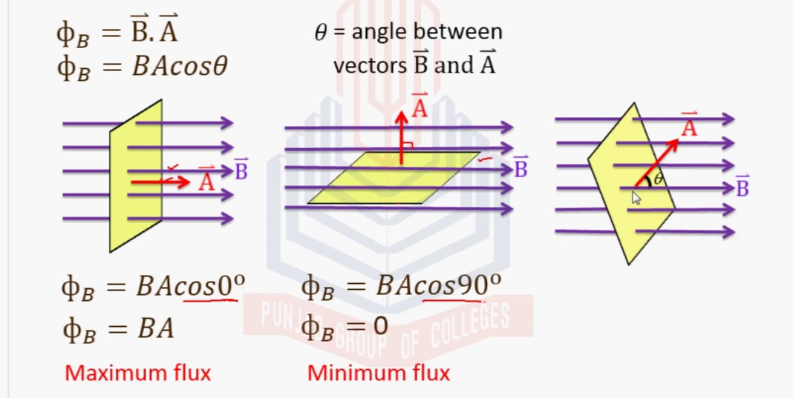
Magnetic flux (φ)
Magnetic flux(φ) [phi] is defined as the number of magnetic field lines passing through a given closed surface. It provides the measurement of the total magnetic field that passes through a given surface area.
Units: Weber (Wb)

Slide 36
Magnetic Induction or Magnetic flux Density(B)
The number of field lines passing through a unit area of cross-section is called magnetic induction or magnetic flux density.
B = Φ/A Units: wb/m² or Tesla.
Magnetic field intensity or strengh (H)
The Magnetic field intensity at any point in the magnetic field is the force experienced by an unit north pole placed at that point.
Units : A/m
B = µ H where µ is the permeability of the medium.
Permeability is a material property which describes the ease with which the magnetic field lines can pass through the material. Units: henry/meter.

Slide 37
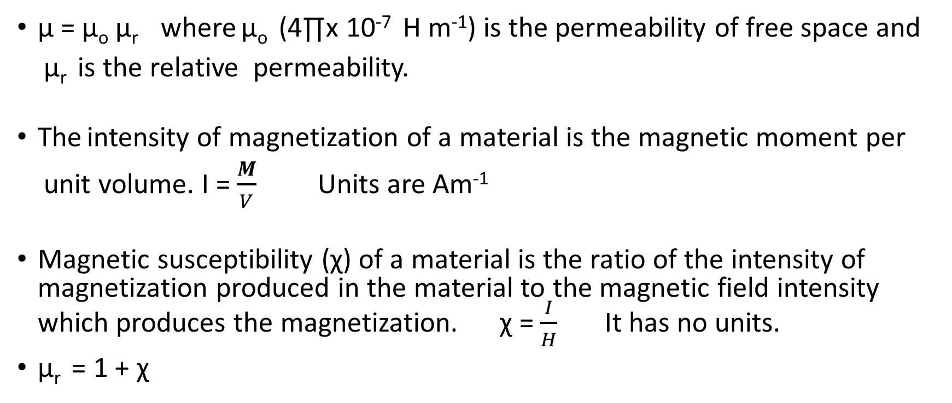
Intensity of magnetization(I)

Slide 38
Origin of Magnetic Moment
In atoms, the permanent magnetic moments can arise due to:
1. the orbital magnetic moment of the electrons
2. the spin magnetic moment of the electrons and
3. the spin magnetic moment of the nucleus.

Slide 39
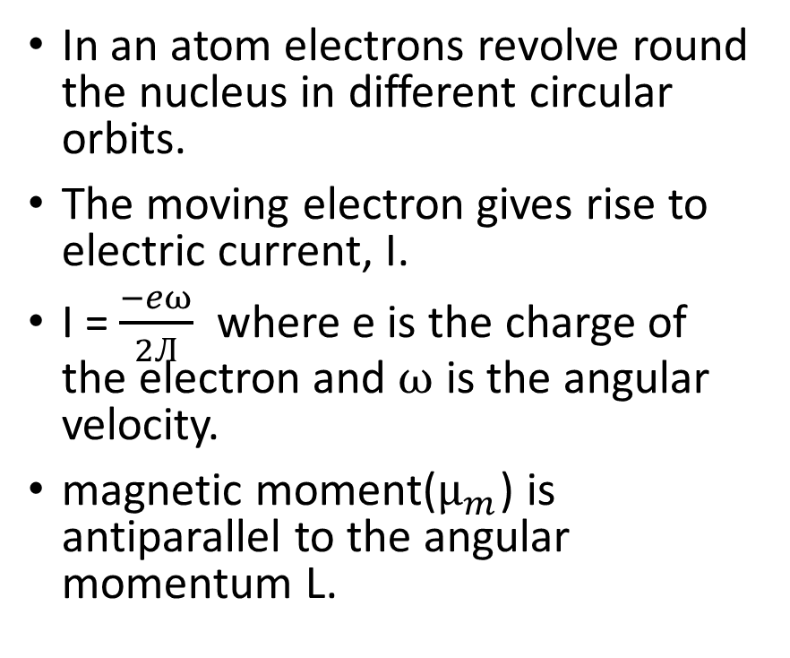
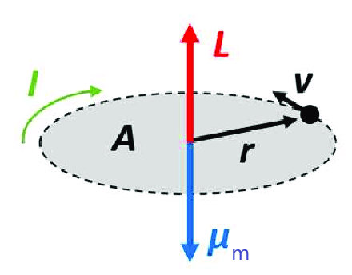
Orbital magnetic moment of the electrons & Bohr magneton

Slide 40
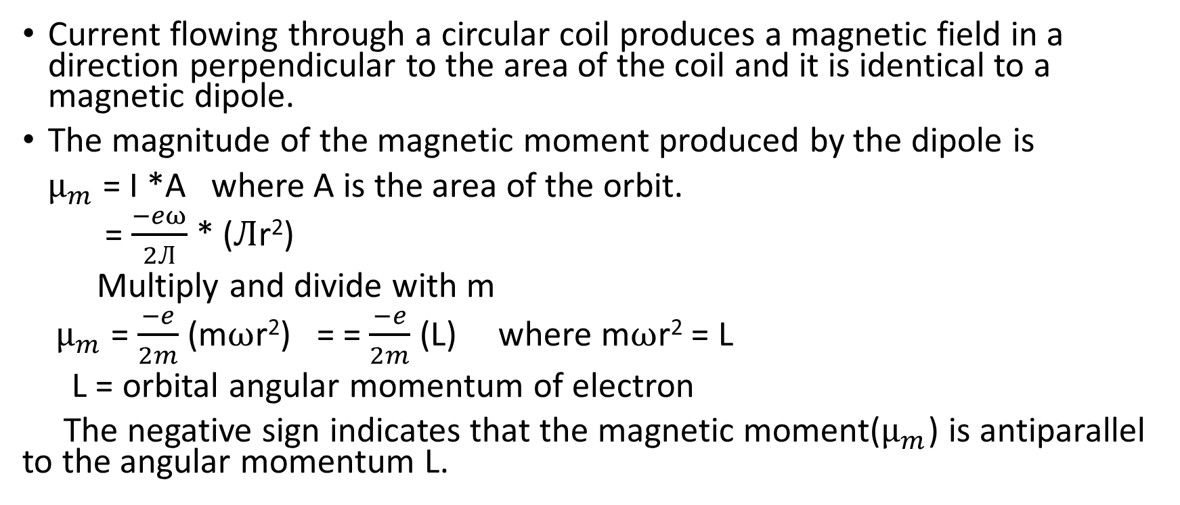
Orbital magnetic moment of the electrons & Bohr magneton

Slide 41
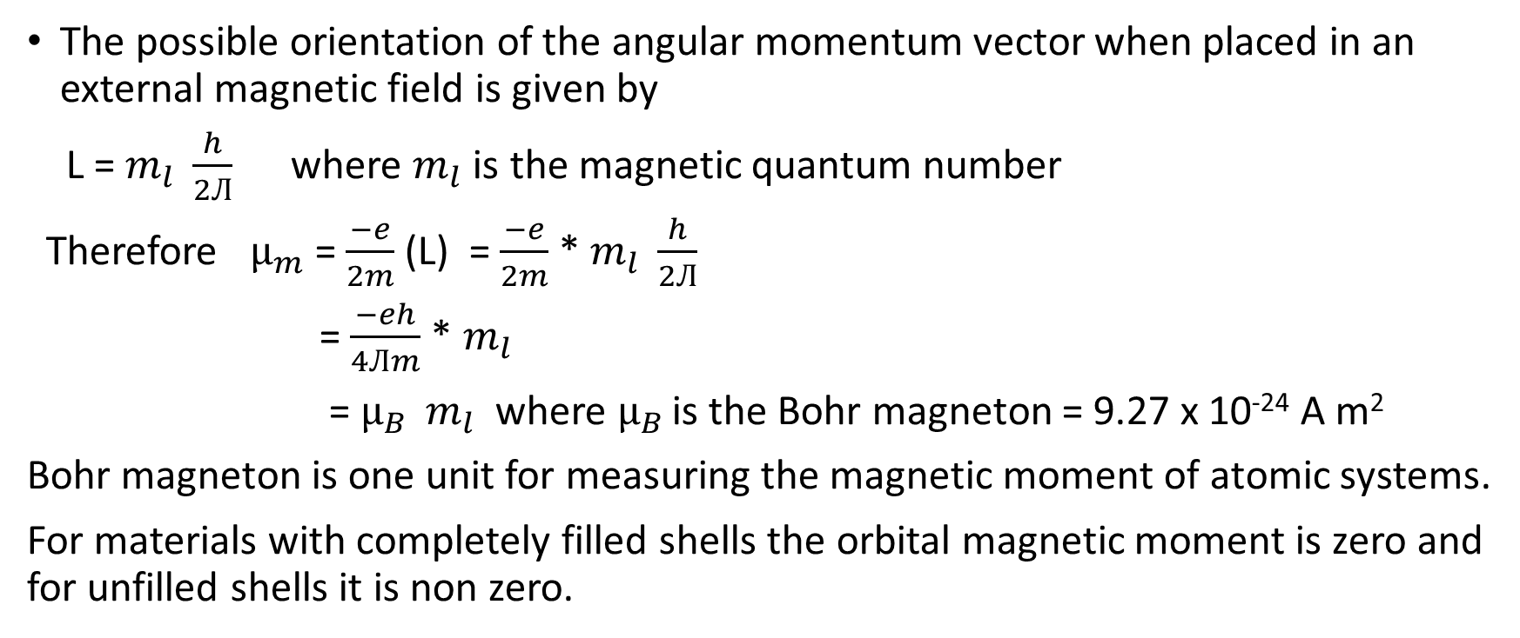
Orbital magnetic moment of the electrons & Bohr magneton

Slide 42
Spin magnetic moment of electron and nucleus
Electron spin: Each electron spins about an axis through itself and this gives rise to a magnetic dipole moment.
The major contribution to atomic magnetic moment comes from the spin of unpaired valence electrons. The magnetic moments due to electron spin align in different directions to generate a non zero magnetic moment. When placed in a magnetic field, the atomic dipoles are aligned with their directions of magnetic moment along the direction of external field.
Nuclear spin: In addition to the contribution of electrons, the nuclear spin also contributes to magnetic moment of atoms. The contribution is negligible.
In general, the total magnetic moment of an atom is the sum of the orbital and spin magnetic moments of its electrons.

Slide 43
Classification of Magnetic Materials
Magnetic materials may be classified based on the atomic dipoles and the interactions between them.
If the atoms of the materials do not have permanent magnetic dipoles, they are called as diamagnetic material.
If the atoms of the materials have permanent magnetic dipoles, they may be paramagnetic, ferromagnetic, antiferromagnetic or ferrimagnetic, depending on the interaction between the individual dipoles.

Slide 44
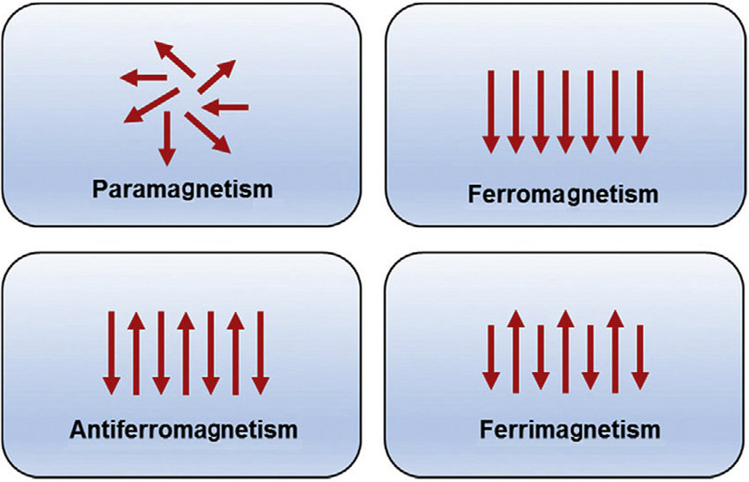
Classification of Magnetic Materials
In paramagnetic materials, the interaction between the atomic magnetic dipoles is negligible.
In ferromagnetic materials the interaction between atomic magnetic dipoles is strong and they are aligned parallel to each other.
If the neighbouring dipoles orient in opposite directions and if the dipoles are of equal magnitude, the material is antiferromagnetic.
If the neighbouring dipoles are of different magnitude and oriented antiparallel, the material is ferrimagnetic.

Slide 45
Diamagnetism
Diamagnetism occurs in materials whose atoms have even number of electrons i.e. electrons are paired.
Due to different orientations of various orbits of an atom, the net magnetic moment is zero.
When an external magnetic field is applied the motion of electrons in their orbits changes resulting in induced magnetic moment in a direction opposite to the direction of external field.
Properties:
Permanent dipoles are absent.
Weak repulsion is the characteristic property of diamagnetism.
Relative permeability is less than one but positive.
The magnetic susceptibility is negative and small. It is not affected by temperature.
When placed inside a magnetic field, magnetic lines of force are repelled.
Examples: Copper, Zinc, Bismuth, Silver, Gold

Slide 46
Paramagnetism
Paramagnetism occurs in materials whose shells are unfilled and hence have net magnetic moment.
In the absence of external magnetic field the net moments of the atoms are arranged in random directions and hence magnetization is zero.
When external field is applied, the dipoles align in the direction of the field giving rise to induced positive dipole moment.
Properties:
Paramagnetic material have permanent magnetic dipoles.
The magnetic susceptibility is small and positive and is inversely proportional to absolute temperature i.e. χ=C/T. This is called curie law, c is called Curie constant.
Spin alignment is random.
When placed inside a magnetic field it attracts the magnetic lines of force.
Examples: Aluminum, Manganese, oxygen

Slide 47
Ferromagnetism
Ferromagnetism arises when the magnetic moments of adjacent atoms are arranged in a regular order i.e. all pointing in the same direction.
These substances possess a magnetic moment even in the absence of the applied magnetic field and is known as the spontaneous magnetization.
There is a special form of interaction called “exchange “coupling occurring between adjacent atoms, coupling their magnetic moment together in rigid parallelism.

Slide 48
Ferromagnetism
Properties:
Ferromagnetism is due to the existence of magnetic domains which can be spontaneously magnetized.
In ferromagnetic materials, large magnetization occurs in the direction of the field.
Strong attraction is the characteristic property of ferromagnetism.
They exhibit spontaneous magnetization.
The relative permeability is very high for Ferro magnetic.
The magnetic susceptibility is positive and very high.
Exhibit hysteresis phenomenon.
When placed inside a magnetic field they attract the magnetic lines of forces very strongly.
Examples: Iron, Nickel, Cobalt.

Slide 49
Hysteresis curve based on domain theory
Domain theory of ferromagnetism
According to Weiss, the specimen of ferromagnetic material have number of regions or domains which are spontaneously magnetized. In each domain spontaneous magnetization is due to parallel alignment of all magnetic dipoles.
The direction of spontaneous magnetization varies from domain to domain.
The resultant magnetization may hence be zero or nearly zero.

Slide 50
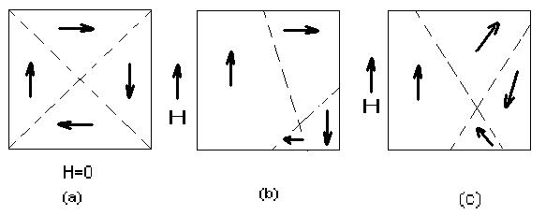
Hysteresis curve based on domain theory
When an external field is applied there are two possible ways for the alignment of domains.
(i) By motion of domain walls: The volume of domains that are favorably oriented with respect to the magnetizing field increases at the cost of those that are unfavorably oriented. Shown in fig (b).
(ii) By rotation of domains: when the applied magnetic field is strong, rotation of the direction of magnetization occurs in the direction of the field. Shown in fig (c).

Slide 51
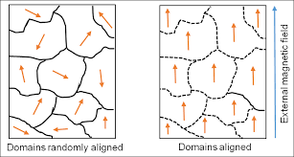
Hysteresis curve based on domain theory
Hysteresis: The hysteresis of ferromagnetic materials refers to the lag of magnetization behind the magnetising field.
In the absence of a magnetic field, the domains in the material are randomly oriented and the resultant magnetic moment is zero.
When an external magnetic field is applied, the domains get oriented in the direction of the external field.

Slide 52
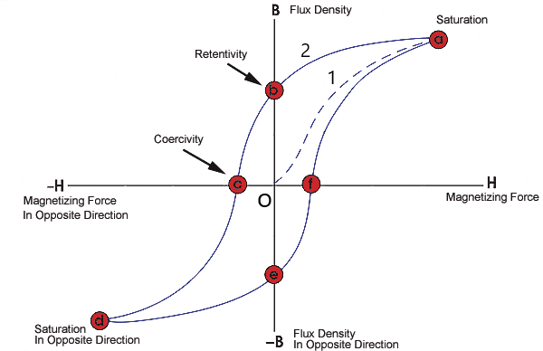
Hysteresis curve based on domain theory
As the external magnetic field (H) is increased, the magnetization of the material proceeds along path 1 from o to a.
Point ‘a’ indicates saturation of magnetization i.e. all the domains are oriented in the direction of the external magnetic field.
When the external magnetic field is reduced back to zero, the magnetization curve takes path 2 i.e. from ‘a’ to ‘b’.

Slide 53
Hysteresis curve based on domain theory
The original path 1 is not traced because of irreversible processes occurring in the course of demagnetization.
Defects such as impurity atoms, dislocations and nonmagnetic inclusions present in the material effect the motion of domain walls.
Domains retain their original orientation even when H =0, leading to remnant induction B_{r} (Point ‘b’).

Slide 54
Hysteresis curve based on domain theory
Elimination of the remanent magnetization(point ‘c’) requires the applied field H (=H_{c}) in opposite direction.
The amount of energy spent to reduce the magnetization (B) to zero is called “coercivity”
Point ‘d’ indicates the saturation in the opposite direction.
Hysteresis loss: It is the loss of energy in taking a ferromagnetic body through a complete cycle of magnetization and this loss is represented by the area enclosed by the hysteresis loop.

Slide 55
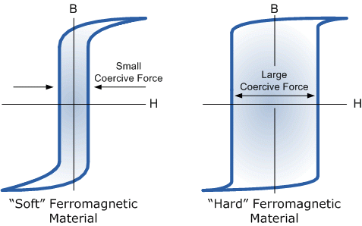
Soft and hard magnetic material
The process of magnetization of a Ferro or Ferri magnetic material consist of moving domains walls so that favorably oriented domains grow. If the domain walls are easy to move and coercive field is low and the material is easy to magnetize. Such a material is called soft magnetic material.
If it is difficult to move the domain walls, the coercive field is large then the material is magnetically hard .These are called hard magnetic material.

Slide 56
Soft and Hard magnetic materials
Soft magnetic materials | Hard magnetic materials
Soft magnetic materials have low hysteresis loss due to small hysteresis loop area | Hard magnetic materials have large hysteresis loss due to large hysteresis loop area.
In these materials the domain wall movement is relatively easier, even for small changes in the magnetizing field the magnetization changes by large amount | In these materials the domain wall movement is difficult because of presence of impurities and crystal imperfection and it is irreversible in nature.
The coercivity and retentivity are small. Hence these materials can be easily magnetized and demagnetized. | The coercivity and retentivity are large. Hence these materials cannot be easily magnetized and demagnetized

Slide 57
Soft and Hard magnetic materials
Soft magnetic materials These materials are free from irregularities; the magneto static energy is small. | Hard magnetic materials In these materials, because of the presence of impurities and crystal imperfection the mechanical strain is more. Hence magneto static energy is large.
These materials have large values of susceptibility and permeability. | These materials have small values of susceptibility and permeability
These are used to make electronic magnets. | These are used to make permanent magnets
Applications: Mainly used in electromagnetic machinery and transformer cores. | Applications: For production of permanent magnets used in magnetic detectors, microphones flux meters and loud speakers.

Slide 58
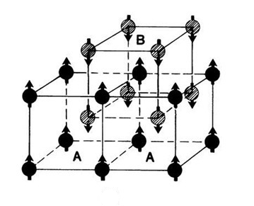
Antiferromagnetism
Antiferromagnetism arises in materials in which the magnetic moments are equal, but adjacent magnetic moments point in opposite directions.
An antiferromagnetic unit cell can be considered as composed of two interpenetrating ferromagnetic sublattices, say A and B as shown in the figure.
The spin of A and B are oriented in opposite
directions.

Slide 59
Antiferromagnetism
When there is no external magnetic field acting on them, the net magnetization is zero.
When placed in a external magnetic field and the temperature is zero, the magnetization is still zero.
As temperature is increased in the presence of external magnetic field, the antiparallel arrangement of spins is slowly disturbed and magnetization( and hence susceptibility) increases.
The susceptibility reaches a maximum at Neel temperature, T_{N}.
At Neel temperature, the spin ordering is lost completely.

Slide 60
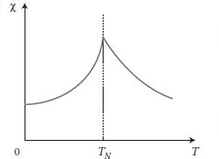
Antiferromagnetism
The susceptibility decreases with further increase in temperature and the material becomes paramagnetic above the Neel temperature.
The elements manganese and chromium exhibit
ferromagnetism at room temperature.
Most of the antiferromagnetic materials are
compounds. Eg. MnO

Slide 61
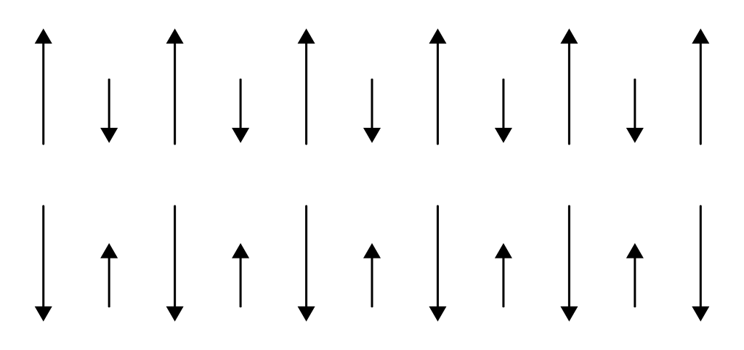
Ferrimagnetism
In certain crystals the magnetic moment of the two sublattices are not exactly equal in magnitude and they are oriented in opposite directions. They have a resultant magnetic moment.
They possess spontaneous magnetization.
Ferrimagnetic materials are very similar to ferromagnetic
materials in their macroscopic magnetic characteristics.
Ferrimagnetic materials are widely used in high frequency applications where ferromagnetic materials cannot be utilized.

Slide 62
Ferrimagnetism
Ferrites:
Ferrimagnetic materials are ceramic materials and are therefore good electrical insulators. The most important group of these materials is ferrites. Garnets constitute another important group.
Ferrites consists of ferric oxide Fe₂O₃, combined with one or more oxides of divalent metals. They are represented by a general formula M Fe₂O₄ or M.O.Fe₂O₃ in which M represents a metallic element.
Example of ferrite is magnetite FeO. Fe₂O₃
Garnets have a very complicated crystal structure and the general formula is M₃Fe₅O₁₂ where M represents a rare earth ion such as samarium, yttrium etc.

Slide 63
Ferrimagnetism
Applications of ferrites:
They are used to produce ultrasonic frequency by magnetization principle.
Ferrites are used in audio and video transformers.
Ferrites rods are used in radio receivers to increase the sensitivity.
Ferrites are used in computers and data processing circuits.
Ferrites are used in switching circuits and in storage devices of computers.

Slide 64
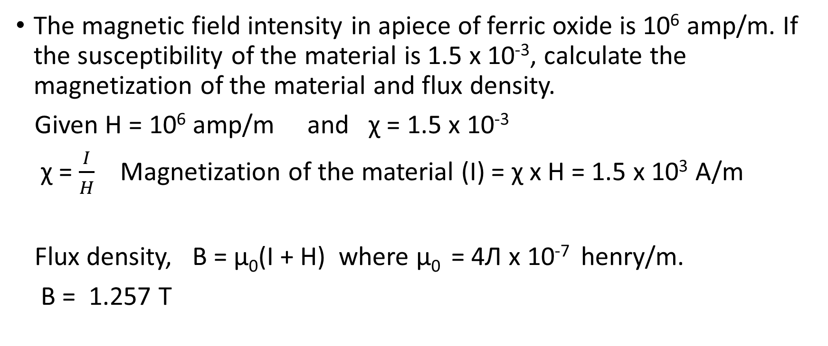
Numericals: Magnetic material

Slide 65
Superconductivity
The phenomenon of superconductivity was first observed by H K Onnes in 1911 when measuring the electrical conductivity of metals at low temperature.
Superconductivity is the phenomenon in which electrical resistance of materials suddenly disappears below a certain temperature. The materials that exhibit superconductivity and which are in the superconducting state are called superconductors.
The temperature at which the transition from normal state to superconducting state takes place on cooling in the absence of magnetic field is called as critical temperature or transition temperature (T_{c}).
The transition is reversible. When the temperature of the material is increased above Tc, it passes in to the normal state.

Slide 66
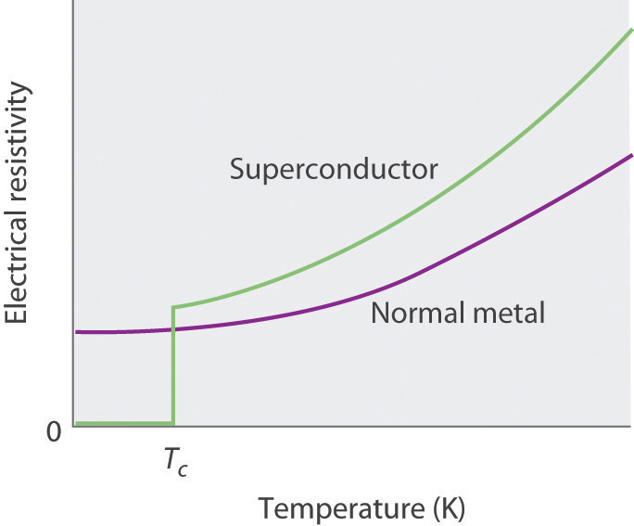
Superconductivity
Transition temperature:
Mercury = 4.15 K
Among pure metals, niobium has highest Tc (9.46 K) and tungsten the lowest(0.015 K)
Ferromagnetic and antiferromagnetic materials are not superconductors.

Slide 67
Properties of Superconductors
Zero electrical resistance
Persistent current
Critical temperature
Critical magnetic field
Perfect diamagnetism – Meissner Effect

Slide 68
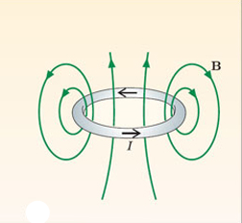
Persistent current
Once a current is started in a closed loop of superconducting material, it will continue to flow as long as the loop is held below the critical temperature.
Such a steady current, which flows without diminishing in strength is called persistent current.
Persistent current gives rise to magnetic field.

Slide 69
Critical magnetic field
Superconductivity disappears if the temperature of the specimen is raised above T_{c} or a strong magnetic field is applied.
The minimum magnetic field which is necessary to regain the normal resistivity is called the critical magnetic field, H_{c}. The value of H_{c} varies with temperature.
At any temperature T < T_{c} the material remains superconducting until a corresponding critical magnetic field is applied.
The critical magnetic field required to destroy the superconducting state decreases with increasing temperature.

Slide 70
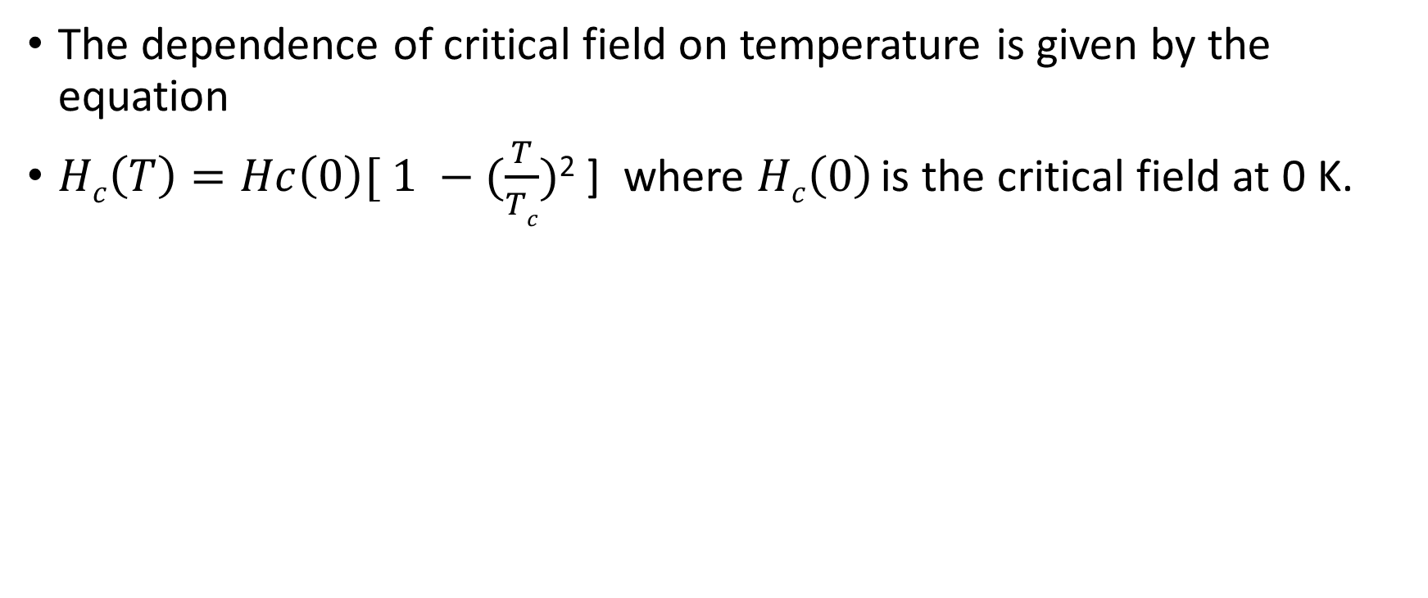
Critical magnetic field

Slide 71
Perfect diamagnetism – Meissner Effect
When superconductors are cooled below their critical temperature in the presence of a magnetic field, the magnetic flux is expelled from the interior of the specimen and the superconductor becomes a perfect diamagnetic. This phenomenon is known as Meissner effect.
Meissner effect is reversible.
The magnetic induction inside the specimen is given by
B = μ₀(H + M) where H is the magnetic field applied externally and M is the magnetization produced within the specimen.

Slide 72
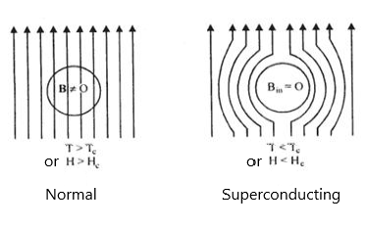
Perfect diamagnetism – Meissner Effect

Slide 73
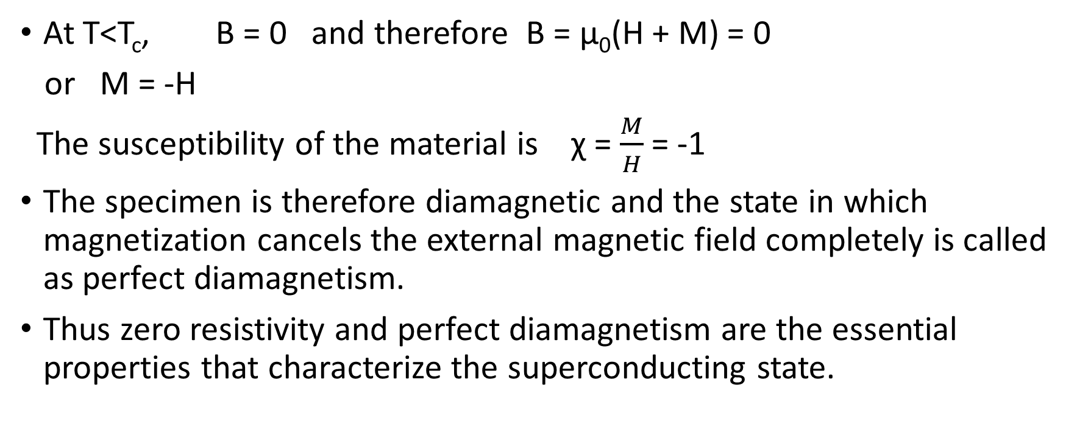
Perfect diamagnetism – Meissner Effect

Slide 74
Perfect diamagnetism – Meissner Effect
Meissner effect is the standard test used to conclusively prove whether a particular material is a superconductor or not.
A smaller magnet repelled by a bigger superconductor hovers in air. This is known as levitation effect. The levitation effect is utilized in the operation of Maglev trains.

Slide 75
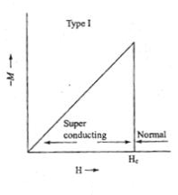
Type I and Type II Superconductors
Type I Superconductors
Superconductors exhibiting a complete Meissner effect (perfect diamagnetism) are called type I superconductors. They are also called as soft superconductors.
When the magnetic field strength is gradually increased, at H = H_{c} the diamagnetism abruptly disappears and the material becomes normal material.
Eg. Al, Zn, Hg
Highest value of H_{c} is about 0.1 wb m⁻²

Slide 76
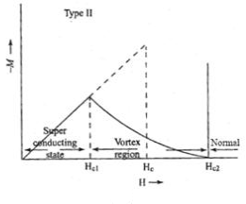
Type I and Type II Superconductors
Type II Superconductors
In type II superconductors, up to field H_{c1}, the specimen is in pure superconducting state. The magnetic flux lines are rejected.
When the field is increased beyond H_{c1}, the lower critical field, the magnetic flux lines start penetrating.
Between lower critical field and upper critical field (H_{c2}), the specimen is in a mixed state or vortex state.

Slide 77
Type I and Type II Superconductors
Type II Superconductors
Above H_{c2}, the specimen is in a normal state.
They are known as hard superconductors.
Eg. Zr and Nb.
H_{c2} can be as high as 20 to 50 wb m⁻²

Slide 78
Applications of Superconductors
Low loss transmission lines and transformers:
Since the resistance is almost zero at superconducting phase, the power loss during transmission is negligible. Hence electric cables are designed with superconducting wires. If superconductors are used for winding of a transformer, the power losses will be very small.
Magnetic levitation:
Diamagnetic property of a superconductor is the basis of magnetic levitation. A superconducting material can be suspended in air against the repulsive force from a permanent magnet. This principle can be used for high speed transportation.

Slide 79
Applications of Superconductors
Generation of high magnetic fields:
Superconducting materials are used for producing very high magnetic fields of the order of 50 tesla. To generate such a high field the power consumed is only 10 KW whereas in conventional method the power consumed is about 3 MW.
Fast electrical switching (Cryotron):
The application of a magnetic field greater than its critical magnetic field changes the superconducting state of a superconducting material to normal state and removal of the field brings the material back from normal state to superconducting state. This fact is used in developing cryotron switches.

